Slide 1
Regular Languages and Regular Expression
A Regular Expression is a pattern that describes a set of strings that matches the pattern.
The languages accepted by finite automata are regular languages and these languages are easily described by simple expressions called regular expressions.

Slide 2
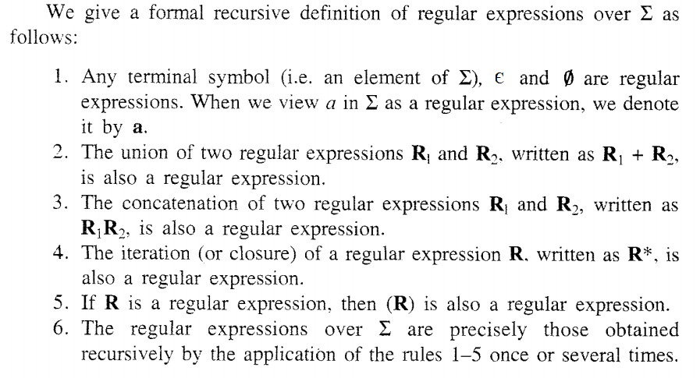
Regular Languages and Regular Expression

Slide 3
Regular Languages and Regular Expression
Examples:
If ∑={a,b}
a is a regular expression (Rule 1)
є is a regular expression (Rule 1)
Φ is a regular expression (Rule 1)
a + b is a regular expression (Rule 2)
ab is a regular expression (Rule 3)
a * is a regular expression (Rule 4)
(a) is a regular expression (Rule 5)
ab + a * b* is a regular expression (Rule 6)

Slide 4
Regular Languages and Regular Expression
Problems on Regular Expressions
Find the regular expressions on following
A language consists of all the words (or strings) over {a,b} ending in b
A language consists of all the words (or strings) over {0,1} ending in 0
A language consists of all the words (or strings) over {a,b} starting with a and ending in b
A language consists of all the words (or strings) over {a,b} having bb as a substring
A language consists of all the words (or strings) over {a,b} ending in abb
A language consists of all the words (or strings) over {0,1} ending in 10

Slide 5
Regular Languages and Regular Expression
Problems on Regular Expressions

Slide 6
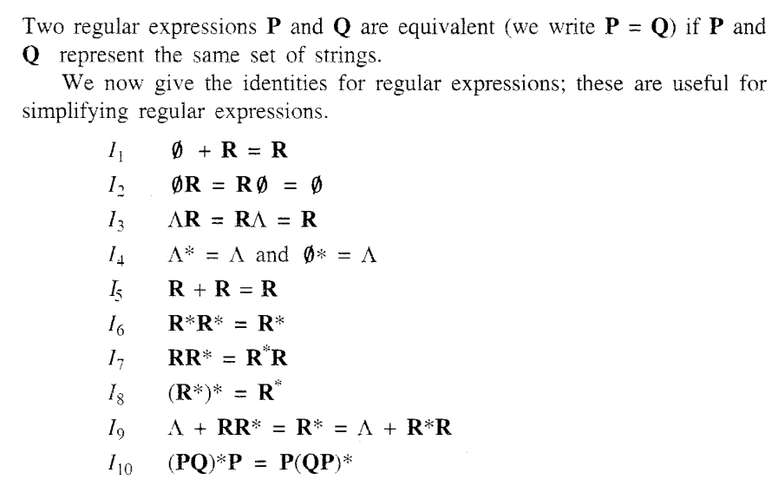
Identities for Regular Expressions

Slide 7
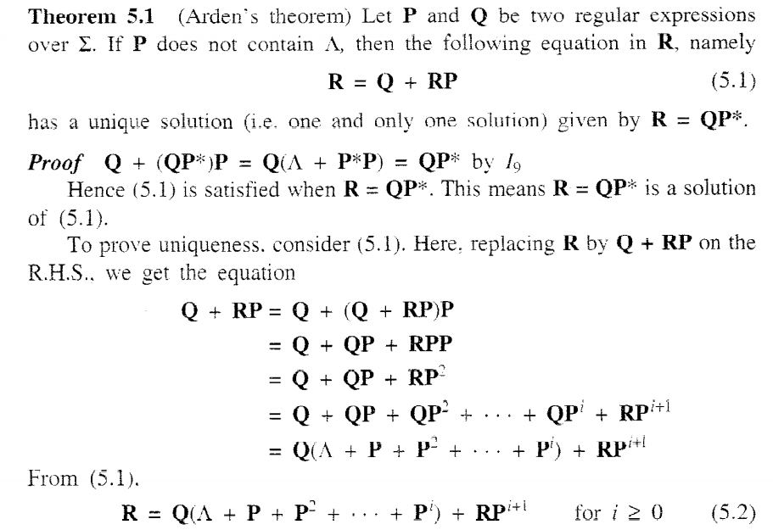
Arden’s Theorem

